Slide 1
Assigment
Brian Sayudha – 07 - 1841720158

Slide 2
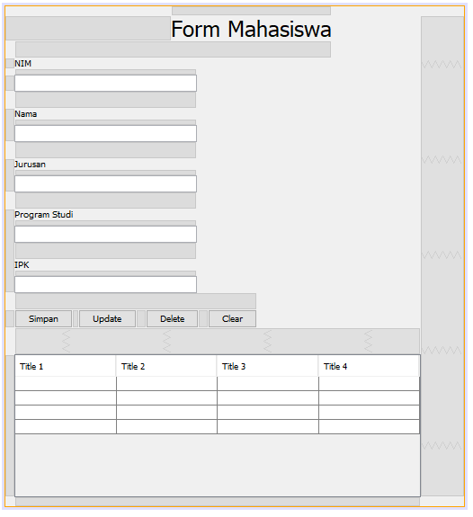
Design

Slide 3
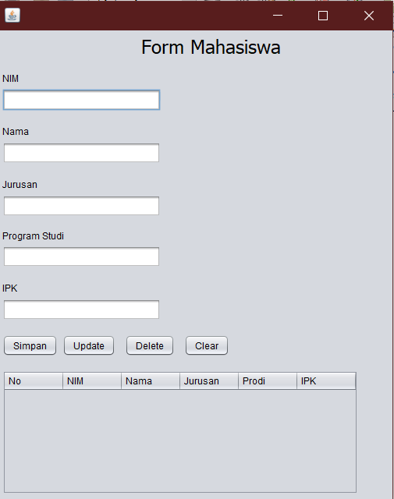
Program Starts (first start)

Slide 4
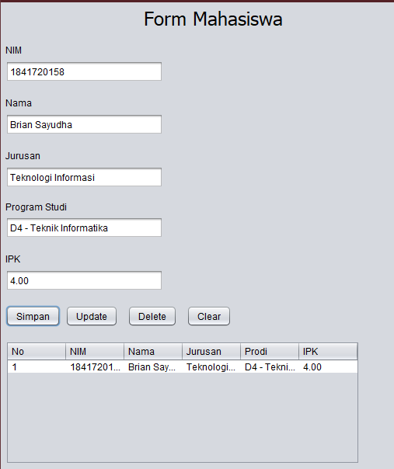
Adding data

Slide 5
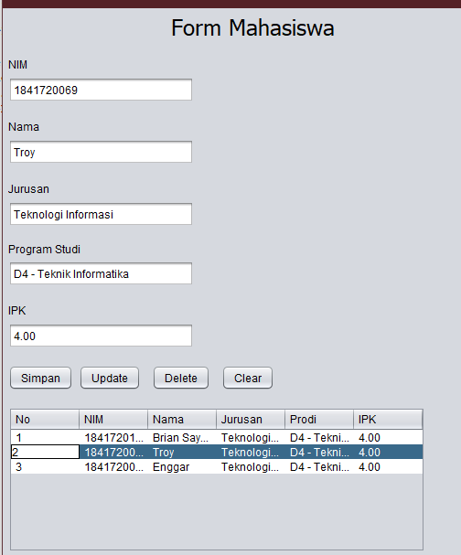
When we click in table

Slide 6
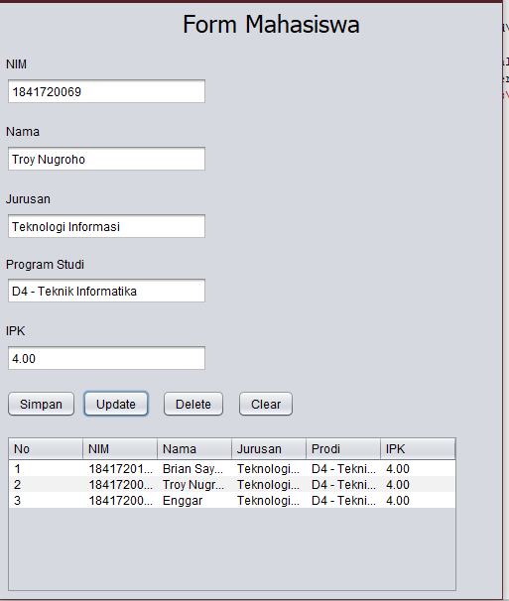
Try Update

Slide 7
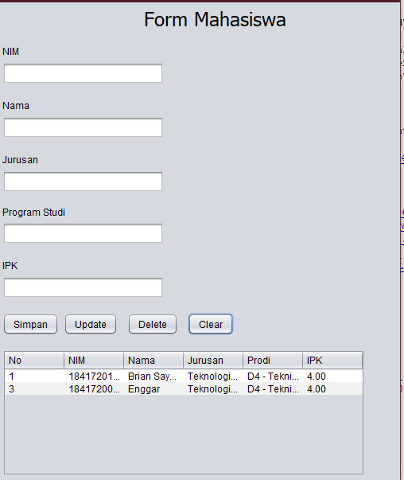
Delete The Second Row

